Slide 1
Update 1/12/23
Changed base_footprint_joint origin statement so tractor wheels are not appearing underground in the simulator.
Consolidated files into https://github.com/jones2126/ros1_lawn_tractor_ws
Used .../src/ackermann_vehicle/nodes/path_generator.py to create a dubins path set of waypoints.
Issues currently:
  Have not further investigated getting teb_planner to run the vehicle at 2 m/s
  Path follower uses move_base_flex which is not currently a part of the simulated world (i.e. It uses move base)
Next steps:
  Work out a path follower routine in the simulator
  Work out the speed issue in the simulator
  Work on the low level controller to take cmd_vel inputs in the ranges generated in the simulator
  Consolidate the programs used for real world into ros1_lawn_tractor_ws

Slide 2
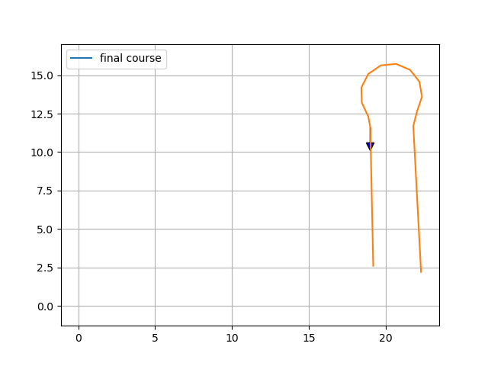
Path generator
https://github.com/jones2126/ros1_lawn_tractor_ws/blob/master/src/ackermann_vehicle/nodes/path_generator.py
Input:
https://github.com/jones2126/ros1_lawn_tractor_ws/blob/master/src/ackermann_vehicle/nodes/waypoint.txt
Output
.../src/ackermann_vehicle/nodes/generated_points.txt
.../src/ackermann_vehicle/maps/first_planned_mission.png

Slide 3
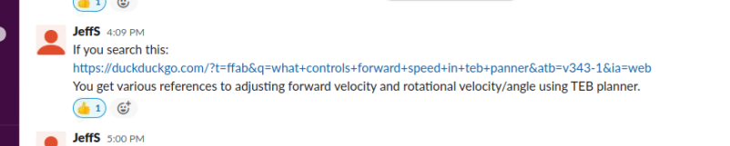
Working on tractor speed in Teb Planner
https://duckduckgo.com/?t=ffab&q=what+controls+forward+speed+in+teb+panner&atb=v343-1&ia=web
https://answers.ros.org/question/273707/teb-local-planner-increasing-x-linear-velocity/
https://answers.ros.org/question/317517/how-to-tune-angular-velocity-using-teb_local_planner/
http://wiki.ros.org/teb_local_planner/Tutorials/Frequently%20Asked%20Questions
http://wiki.ros.org/teb_local_planner/Tutorials/Setup%20and%20test%20Optimization
https://mowito-navstack.readthedocs.io/en/latest/step_5c.html

Slide 4
Bringup Process – real world
At the moment the start-up process is:
1183 roslaunch /home/tractor/catkin_ws/src/nmea_navsat_driver/launch/nmea_to_odom.launch
1184 roslaunch /home/tractor/catkin_ws/src/lawn_tractor_sim/launch/ros1_navigation.launch
1270 roslaunch /home/tractor/catkin_ws/src/lawn_tractor_sim/launch/mbf.launch
965 source devel/setup.bash
Debugging tools:
  !880 rosrun tf2_tools view_frames.py && evince frames.pdf
  $ cd bagfiles && rosbag record -a
Running the rosbag
!1630 $ roslaunch /home/tractor/catkin_ws/src/lawn_tractor_navigation/launch/rosbag_playback.launch
!1650 $ rosbag play -l /home/tractor/bagfiles/2022-12-21-16-36-01.bag

Slide 5
Bringup Process – simulated world
At the moment the start-up process is:
1740 roslaunch ackermann_vehicle_gazebo ack_new.launch
1741 roslaunch nav nav_newteb.launch
1754 rviz -d /home/tractor/catkin_ws/src/lawn_tractor_sim/lawn_tractor_v2.rviz (needs updating to use 435…. map)
Debugging tools:
  !880 rosrun tf2_tools view_frames.py && evince frames.pdf
  $ cd bagfiles && rosbag record -a
Running the rosbag
!1630 $ roslaunch /home/tractor/catkin_ws/src/lawn_tractor_navigation/launch/rosbag_playback.launch
!1650 $ rosbag play -l /home/tractor/bagfiles/2022-12-21-16-36-01.bag

Slide 6
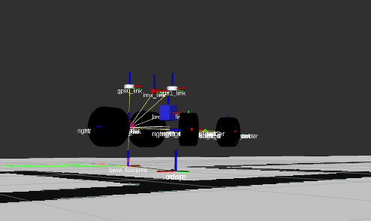
I made this change and now the vehicle is above ground. I don’t know if this is the combination of two changes, but I’m changing it back
/home/tractor/catkin_ws/src/picar/src/ackermann_vehicle_description/urdf
<!-- <origin xyz="-0.1 0 0"/> changed below trying to get the tires out of the dirt-->
<origin xyz="0 0 0"/>

Slide 7
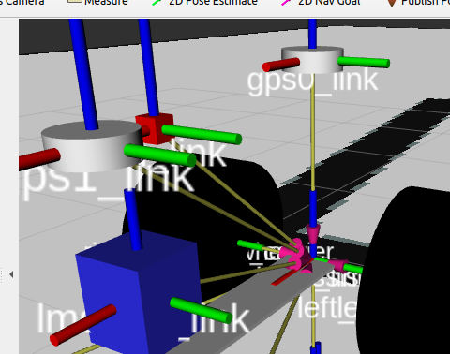
There appear to be two gps links defined

Slide 8
Update 12/29/22
Driven around the map previously created.
Used lawn tractor URDF, Move Base and backyard map to monitor cmd_vel values
  +/- .7 for angular velocity
Next steps:
  Resolve TF issue
  Do another actual run and video the screen of the laptop
  Pick points to run a 2D Nav goal test
  Create “odom2” from wheel and IMU data and switch to that when RTK drops

Slide 9
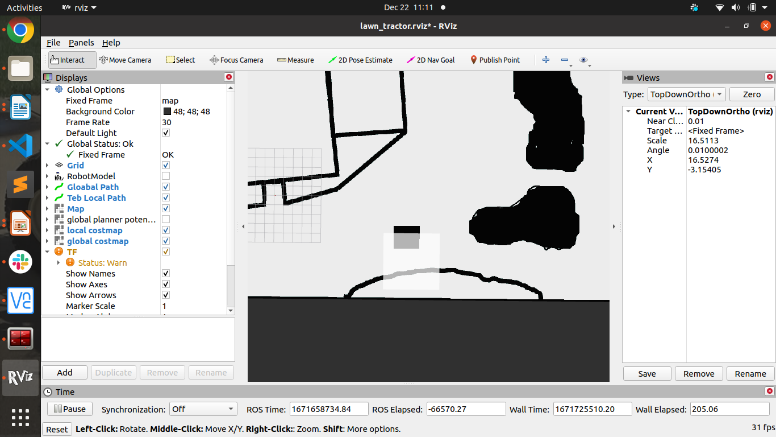
Driving Results

Slide 10
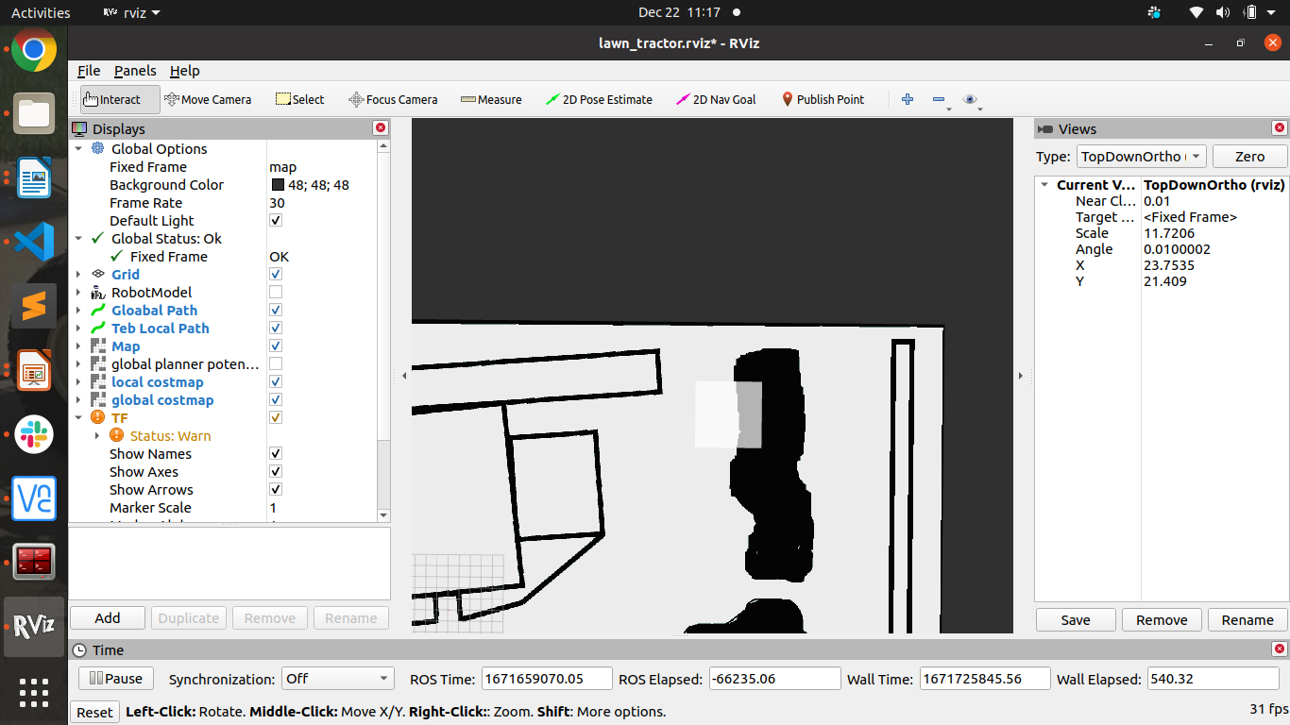
Driving Results

Slide 11
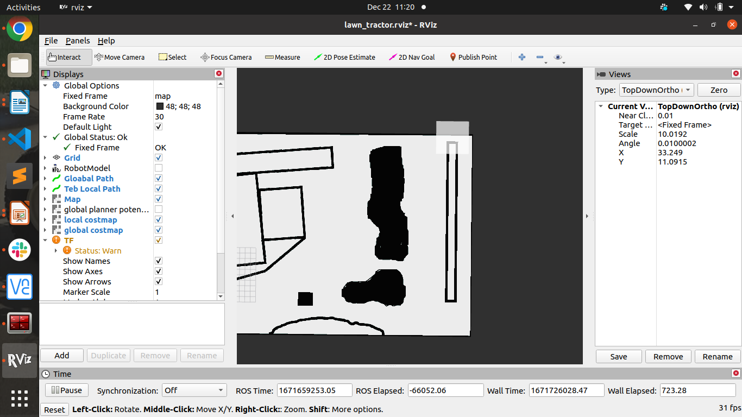
Driving Results

Slide 12
Update 12/16/22
Drafted a map for new yaml file for Pennsylvania back yard; I’ve driven around and captured a bagfile. I need to get it to display in RVIZ.
  Problem statement:
    The .png image of my yard is not displaying in rvis
    The tractor image is not moving
    There are Robot Model errors
Rebuilt 12 volt battery to add a JBD Smart 4S Battery Management System (BMS) - link
Put potentiometers on-board tractor to dynamically adjust steering PID
Updated catkin_ws including moving C++ programs for ttgo and sensors to “embedded” folder

Slide 13
Development Roadmap
Hardware
Tractor Electronics Board Setup
Steering Hardware
Transmission Hardware
Laptop Hardware
12 Volt Setup with BMS
Tractor GPS Setup
Base Station GPS Setup
Tractor Relay Hardware
eStop Hardware
Tractor TTGO LoRa Hardware
RC TTGO LoRa Hardware
Testing
Steering
Radio Control
Transmission
Software
Ubuntu 20.04 installed
Base ROS installed
ROS Ag components installed
“Jeff’s” simulator
Updated Map
Update heading code in nmea
Testing
GPS RTK, NMEA
2D Nav Goal
Tuning
Steering PID
Transmission PID
ROS Navigation
Testing
Steering
Radio Control
Transmission
GPS RTK, NMEA
2D Nav Goal

Slide 14
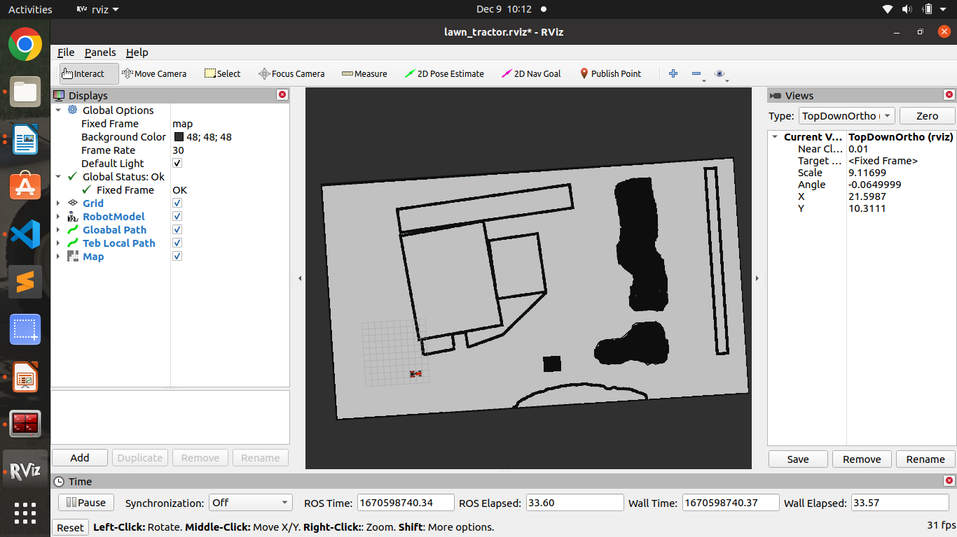

Slide 15
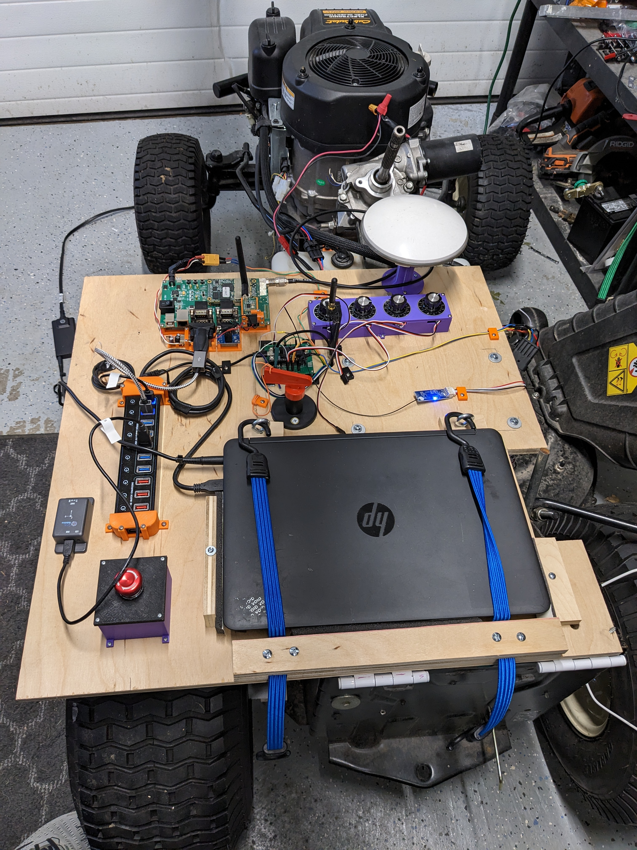

Slide 16
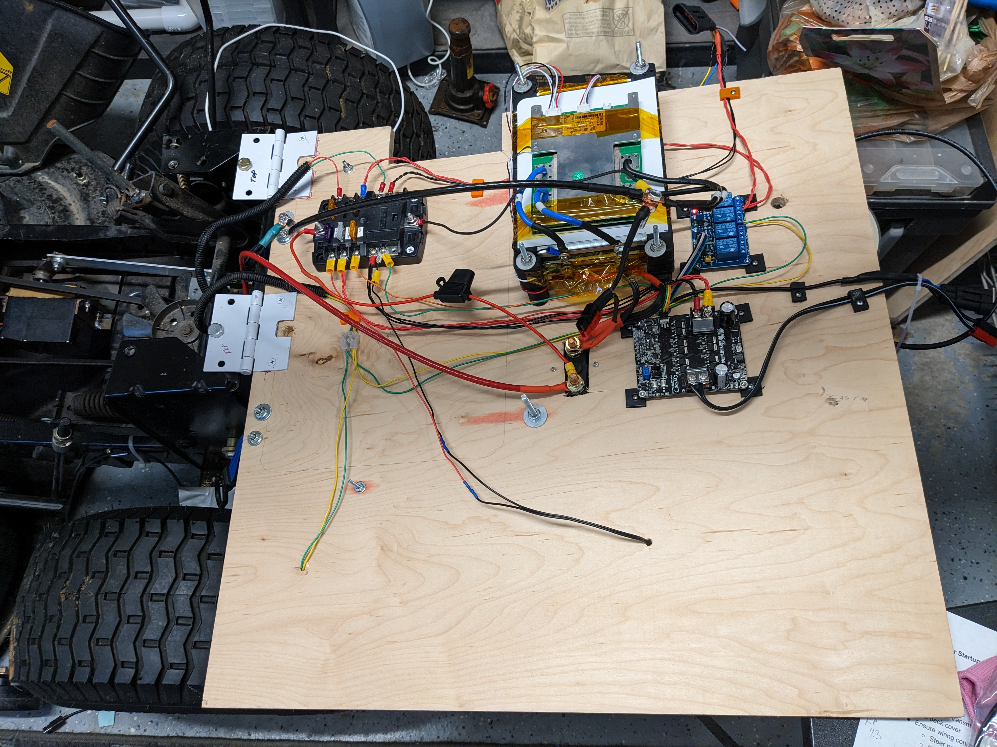

Slide 17
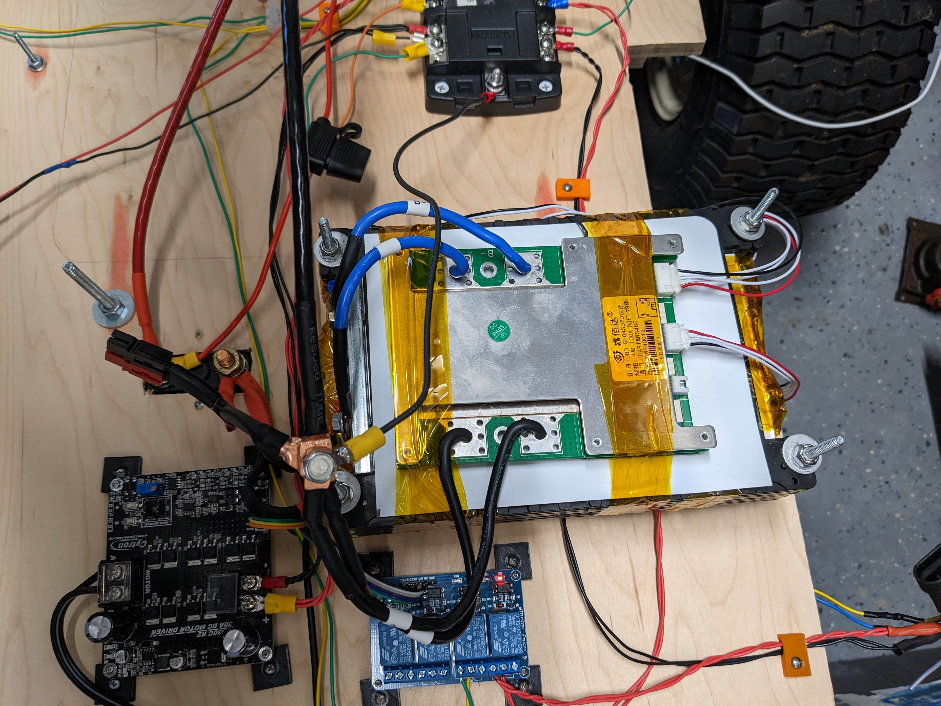

Slide 18
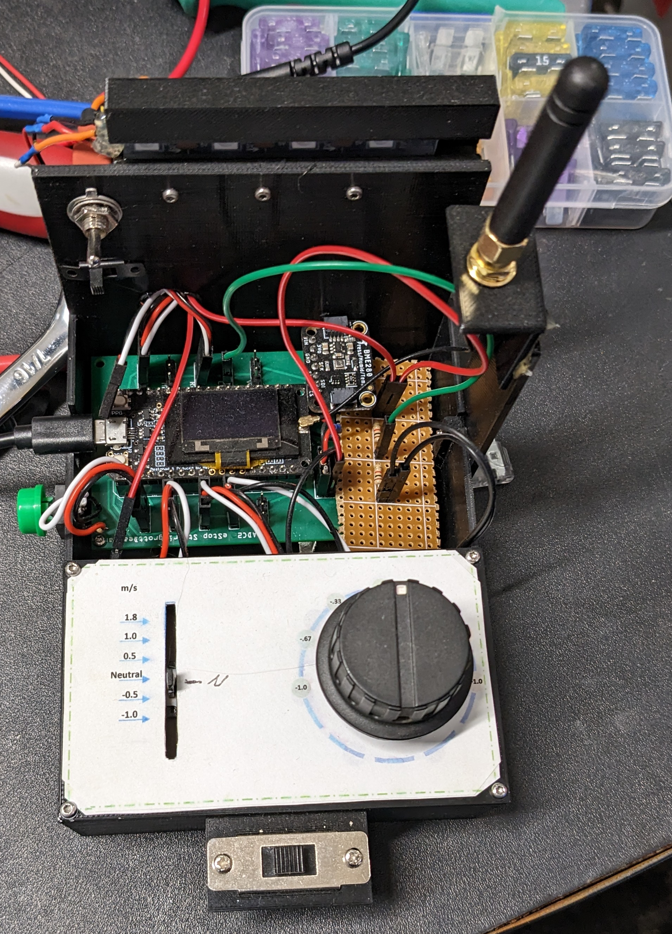

Slide 19
Update 12/9/22
Move_base_flex now appears to be publishing a command velocity command
Drafted a map for new yaml file for Pennsylvania back yard
Rebuilt another Ubuntu machine. The idea is to git clone ROSAg and see if the whole repository being cloned still works

Slide 20
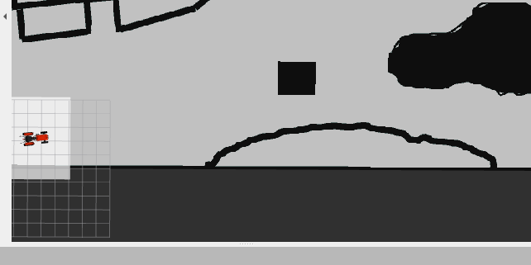
origin: [-15.8, -0.0, 0.0]

Slide 21
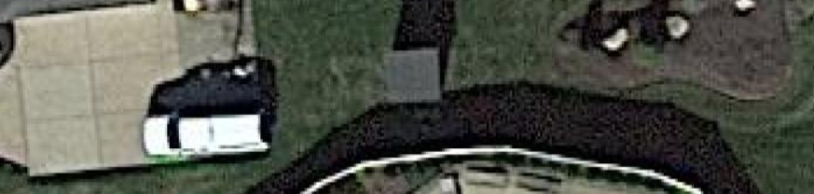

Slide 22
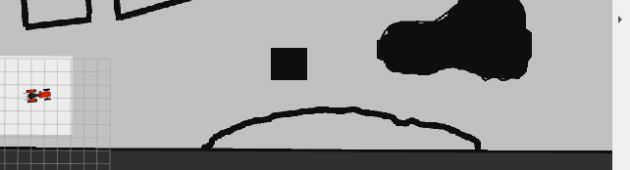
origin: [-15.8, -2.0, 0.0]

Slide 23
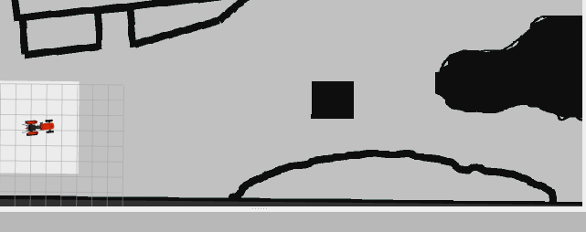
origin: [-15.8, -2.5, 0.0]

Slide 24
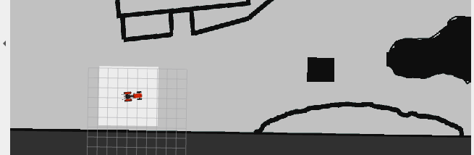
origin: [-15.8, -1.5, 0.0]

Slide 25
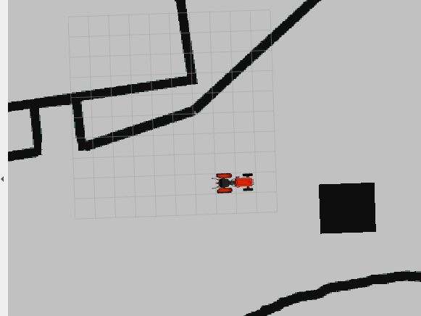
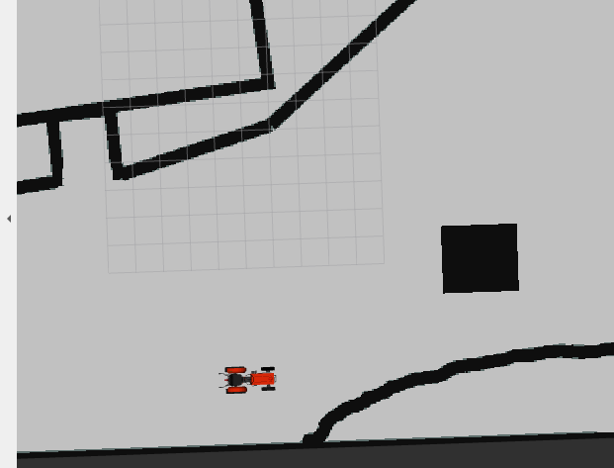
I moved 2 steps South and 7 steps West

Slide 26
origin: [-10.0, -10.0, 0.0]

Slide 27
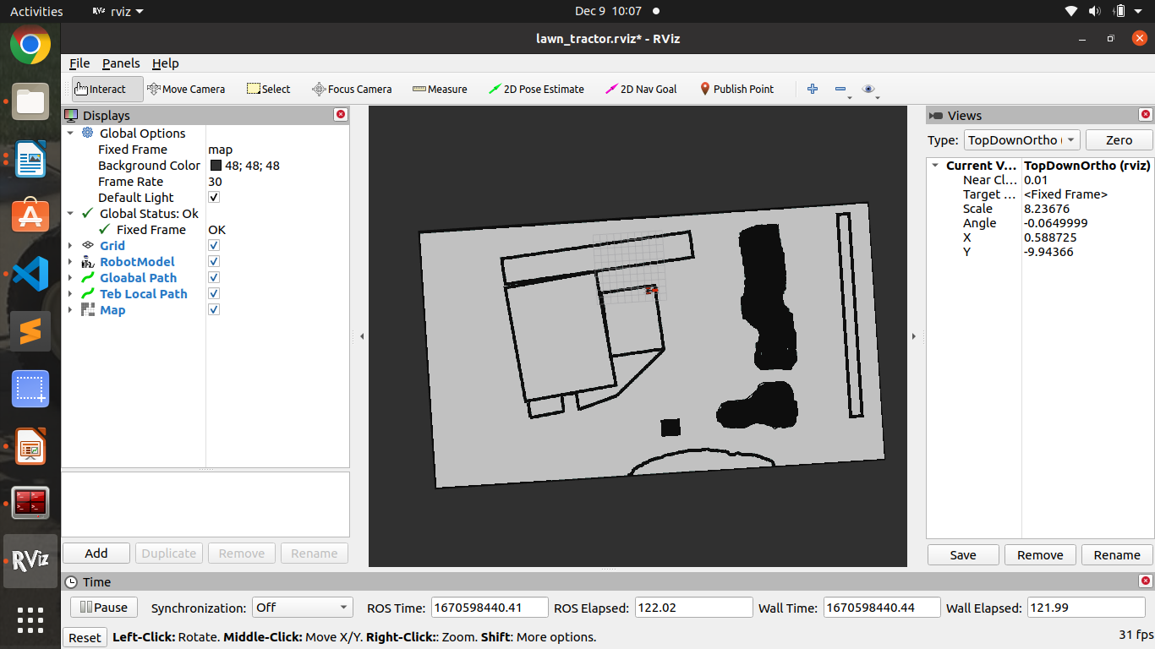
origin: [-30.0, -30.0, 0.0]

Slide 28
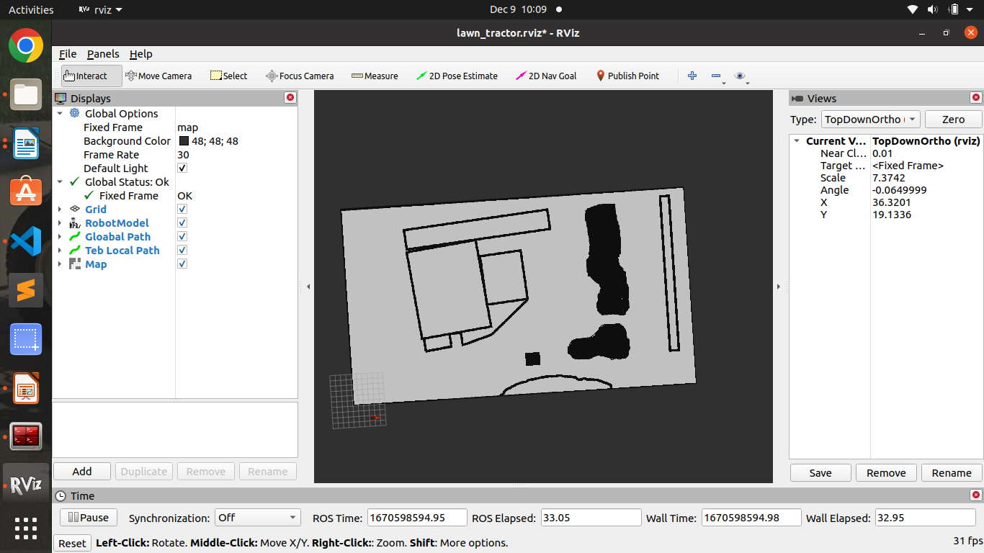
origin: [-1.0, -1.0, 0.0]

Slide 29
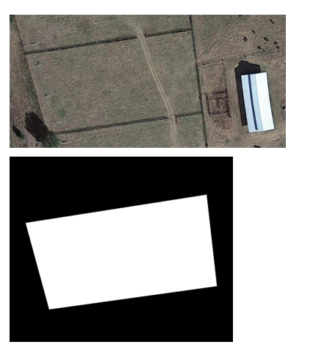
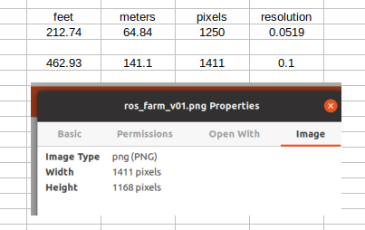
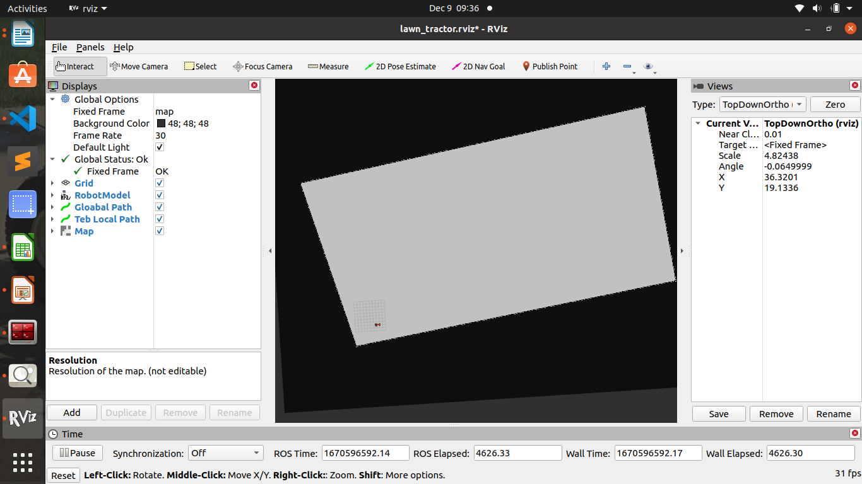

Slide 30
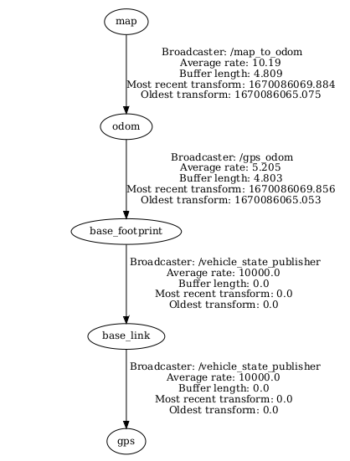
Debugging tools
880 rosrun tf2_tools view_frames.py && evince frames.pdf
501 rosrun rqt_graph rqt_graph

Slide 31
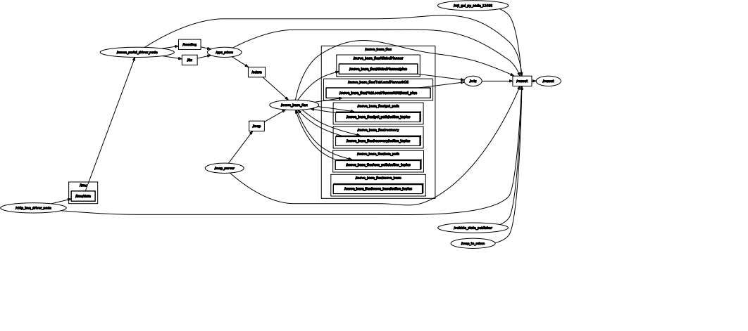

Slide 32
Target Speed (m/s)
Target heading
Ackerman
CMD Vel
Joystick
Steer_Angle_Teensy
/dev/tractor_steering
Speed Target (m/s)
Actual speed (left) (m/s)
Actual speed (right) (m/s)
Calculate microseconds to reach target steering angle
Calculate microseconds to reach target speed
AS5048B
Target heading
/dev/tractor_transmision
Transmission Teensy
Raw Angle
(I2C)
Pin 18 - SDA
Pin 19 - SCL
[ackermann_msgs/AckermannDriveStamped]:
float32 steering_angle - radians
Pin ??
Pin 20
ROS Data Bus
Actual speed (left) (m/s)
writeMicroseconds(value);
Left_Speed Teensy
/dev/tractor_left_odom
Pin 18 - SDA
Pin 19 - SCL
Steering Motor
Control board
Raw Angle
(I2C)
Super Servo
DD-DUOJI
Control board
AS5048B
Actual speed (right) (m/s)
writeMicroseconds(value);
Right_Speed Teensy
/dev/tractor_right_odom
Pin 18 - SDA
Pin 19 - SCL
Raw Angle
(I2C)
AS5048B

Slide 33


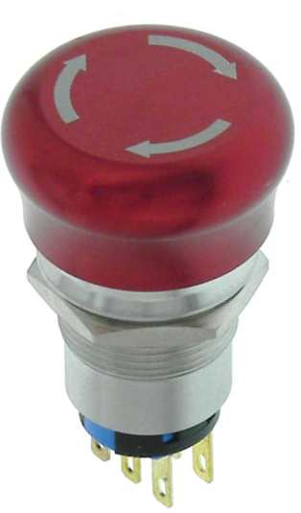



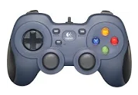
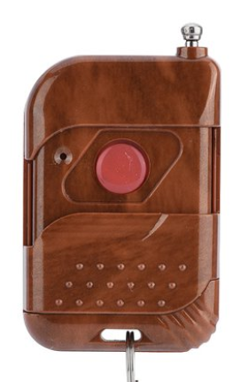
Electronics Box
Engine
GPS Base Station
12 Volt
+
-
3DR Radio 915hz
RS232 to TTL
E-Stop 433Mhz Relay
Magneto
Engine Kill
RPi 3b
GNSS Corrections
MOFI4500 LTE Router
12V to 5V
12 Volt
USB WiFi
Comnav K706 GNSS OEM GPS
GND
Fuel Solenoid
Comnav K706 GNSS OEM GPS
CableCreation USB to RS232 Adapter with FTDI Chipset
GNSS Corrections
Starter
12V to 5V
5V
Manual e-stop
3DR Radio 915hz
RS232 to TTL
USB Hub
8 Channel Relay
Throttle
5V
Steering
Teensy 3.5
Cytron Motor Controller
IMU
GND
PWM
Analog
Ground Control
Teensy 3.2
Drive
5V
GND
SDA
SCL
AMS AS5048B
Lenovo T530
Angle Sensor
Teensy 3.2
Teensy 3.2
Teensy 3.2
E-Stop Wireless key fob
433 Mhz
5V
GND
SDA
SCL
5V
PWM
GND
5V
GND
SDA
SCL
Logitech F310
AMS AS5048B
Super Servo 200
AMS AS5048B
Left Speed
Transmission
Right Speed

Slide 34
North
Heading: 360 °
Yaw: 1.57
ChipRobotics = 90 (i.e. 1.57* 180.0 / PI )
Heading: 270.1 °
Yaw: 3.14
ChipRobotics = 180
West
East
Heading: 269.9 °
Yaw: -3.14
ChipRobotics = -180
Heading: 90 °
Yaw: 0
ChipRobotics = 0
South
Heading: 180 °
Yaw: -1.57
ChipRobotics = -90 (i.e. -1.57*180) / PI())

Slide 35
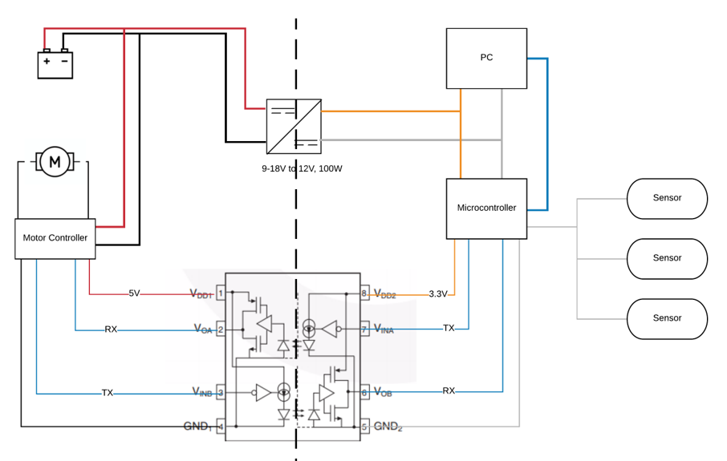
Ground Isolation Suggestion

Slide 36
Target Speed (m/s)
Target heading
Ackerman
CMD Vel
Joystick
Steer_Angle_Teensy
/dev/tractor_steering
Speed Target (m/s)
Actual speed (left) (m/s)
Actual speed (right) (m/s)
Calculate microseconds to reach target steering angle
Calculate microseconds to reach target speed
AS5048B
Target heading
/dev/tractor_transmision
Transmission Teensy
Raw Angle
(I2C)
Pin 18 - SDA
Pin 19 - SCL
[ackermann_msgs/AckermannDriveStamped]:
float32 steering_angle - radians
Pin ??
Actual speed (left) (m/s)
Pin 20
ROS Data Bus
writeMicroseconds(value);
writeMicroseconds(value);
/dev/tractor_left_odom
Left_Speed Teensy
Pin 18 - SDA
Pin 19 - SCL
Super Servo
DD-DUOJI
Control board
Steering Motor
Control board
Raw Angle
(I2C)
AS5048B
Actual speed (right) (m/s)
Right_Speed Teensy
/dev/tractor_right_odom
Pin 18 - SDA
Pin 19 - SCL
Raw Angle
(I2C)
AS5048B

Slide 37
MUX Package: https://github.com/danielsnider/simple_drive
Target Speed: [cmd_vel]: linear.x (i.e. m/s)
Target heading: [cmd_vel]: angular.z
TBD – additional safety and obstacle avoidance
CMD Vel
MUX
Teb Planner
Steer_Angle_Teensy
Joystick
/dev/tractor_steering
Target Speed [cmd_vel]: linear.x (i.e. m/s)
Left speed: [left_speed].data (m/s)
Right speed: [right_speed].data (m/s)
Safety Message: TBD
Calculate angle delta to reach target steering angle and send correct writeMicroseconds(value); statement
Calculate delta to reach target speed. Write correct microseconds
AS5048B
Target heading
/dev/tractor_transmision
Transmission Teensy
Raw Angle
(I2C)
[cmd_vel]: angular.z
(a.k.a. rotational velocity)
Values: +/--0.3 - map to PWM
Pin 18 - SDA
Pin 19 - SCL
Pin 20
Pin ??
ROS Data Bus
Actual speed (left) (m/s)
writeMicroseconds(value);
writeMicroseconds(value);
/dev/tractor_left_odom
Left_Speed Teensy
Pin 18 - SDA
Pin 19 - SCL
Super Servo
DD-DUOJI
Control board
Steering Motor
Control board
Raw Angle
(I2C)
AS5048B
Actual speed (right) (m/s)
Right_Speed Teensy
/dev/tractor_right_odom
Pin 18 - SDA
Pin 19 - SCL
Raw Angle
(I2C)
AS5048B

Slide 38
Electronics Box
Engine
GPS Base Station
12 Volt
+
-
12 Volt
RPi 3b
3DR Radio 915hz
RS232 to TTL
E-Stop 433Mhz Relay
Magneto
Engine Kill
GNSS Corrections
MOFI4500 LTE Router
12V to 5V
USB WiFi
Comnav K706 GNSS OEM GPS
GND
Fuel Solenoid
Comnav K706 GNSS OEM GPS
CableCreation USB to RS232 Adapter with FTDI Chipset
GNSS Corrections
5V
Starter
3DR Radio 915hz
RS232 to TTL
12V to 5V
Manual e-stop
Throttle
USB Hub
5V
8 Channel Relay
Steering
IMU
Teensy 3.5
Cytron Motor Controller
GND
PWM
Analog
Ground Control
Teensy 3.2
Drive
5V
GND
SDA
SCL
AMS AS5048B
Lenovo T530
Angle Sensor
Teensy 3.2
Teensy 3.2
Teensy 3.2
E-Stop Wireless key fob
433 Mhz
5V
GND
SDA
SCL
5V
PWM
GND
5V
GND
SDA
SCL
Logitech F310
AMS AS5048B
Super Servo 200
AMS AS5048B
Left Speed
Transmission
Right Speed

Slide 39
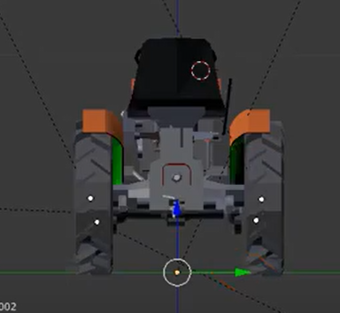
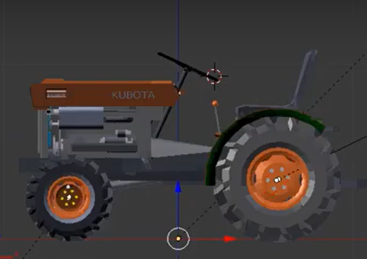
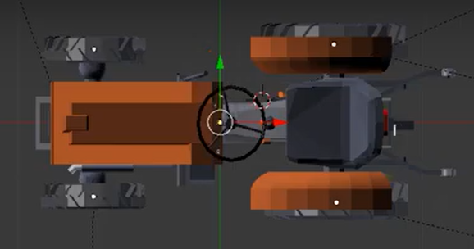

Slide 40
North
Heading: 360 °
Yaw: 1.57
Heading: 270.1 °
Yaw: 3.14
West
East
Heading: 269.9 °
Yaw: -3.14
Heading: 90 °
Yaw: 0
Background: https://math.stackexchange.com/questions/711469/how-to-read-negative-radians-in-the-interval
South
Heading: 180 °
Yaw: -1.57

Slide 41
North
Heading: 360 °
Yaw: 1.57
ChipRobotics = 90 (i.e. 1.57* 180.0 / PI )
Heading: 270.1 °
Yaw: 3.14
ChipRobotics = 180
West
East
Heading: 269.9 °
Yaw: -3.14
ChipRobotics = -180
Heading: 90 °
Yaw: 0
ChipRobotics = 0
South
Heading: 180 °
Yaw: -1.57
ChipRobotics = -90 (i.e. -1.57*180) / PI())

Slide 42
Ground Isolation Suggestion

Slide 43
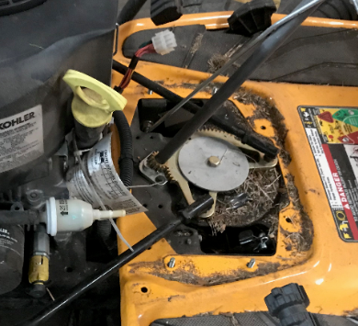
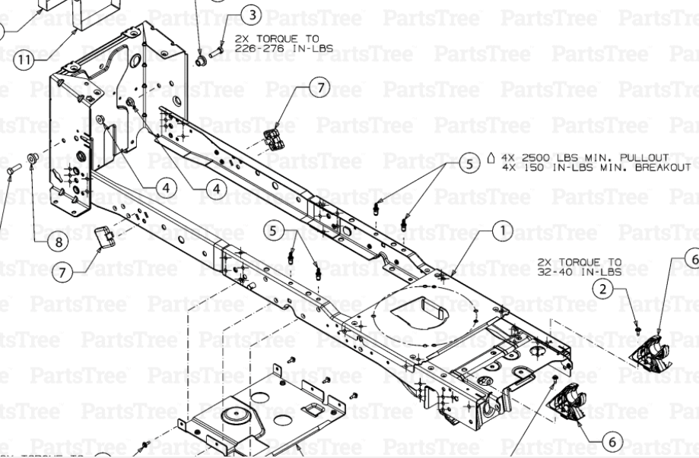
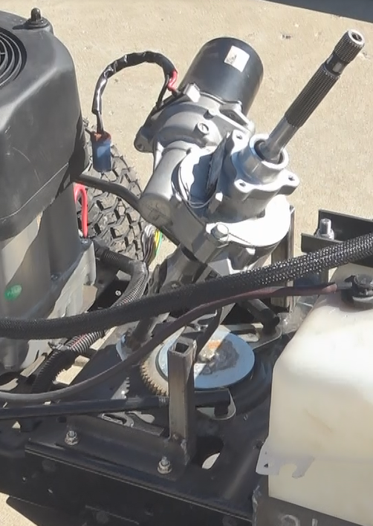
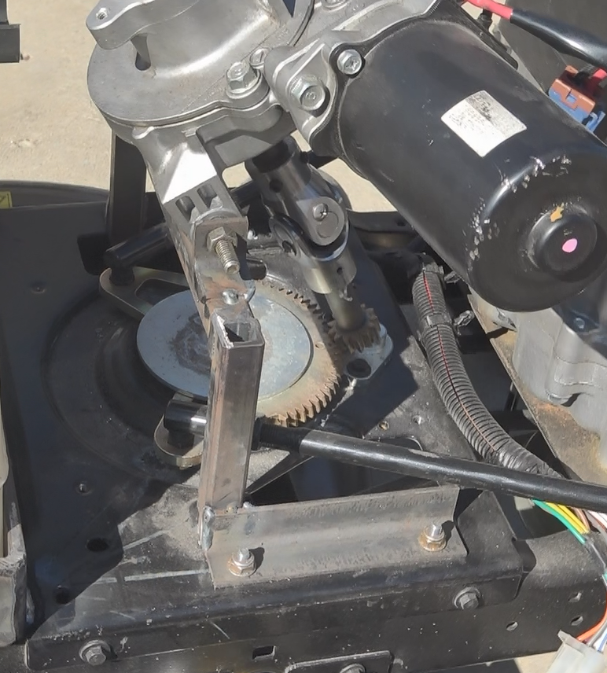
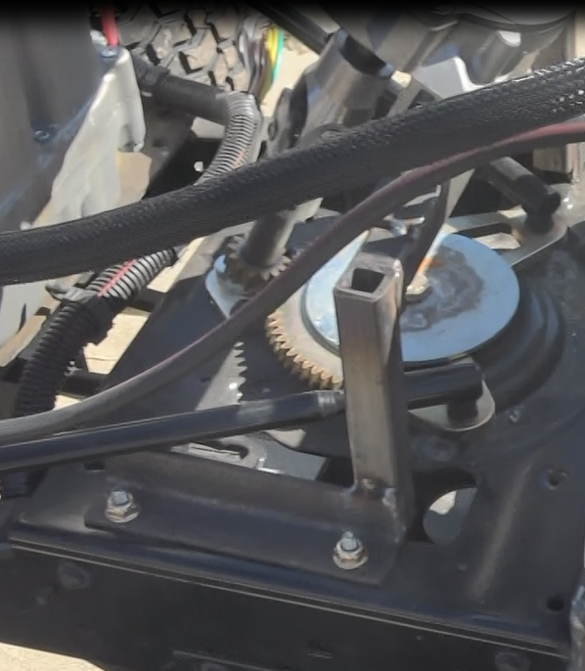

Slide 44
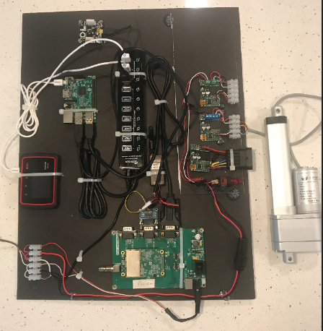
APANAGE 11 Port USB Powered Hub ($40)
Tinkerforge IMU ($75)
Jrk 12v12 USB Motor Controller with Feedback (6) (one each: steering, clutch, brake , throttle, PTO, lift) ($600)
Jrk 21v3 USB Motor Controllers are $50
Raspberry Pi 3 ($35)
Glideforce LACTxx Light-Duty Linear Actuator with Feedback (5 X $129 = $650)
Steering control motor and angle sensor (not shown) ($200)
Verizon Jetpack ($40/mth)
3DR Radio 915MHZ Transceiver
1 – Rover; 1 Base station (not shown) ($20)
Terminal Blocks with
barrier ($10)
Cable Creation USB to RS232 Adapter Female DB9 Serial Converter ($9)
MAX3232 RS232 Serial Port To TTL Converter Module DB9 Connector ($5)
ComNav K503 Development Board with K501G GPS
1 – Rover; 1-Base Station plus antennae’s (not shown) ($1,800)
Total Cost: $3,450 + $40/mth
Drotek XXL RTK GPS + Tiny RTK with antennae $900

Slide 45
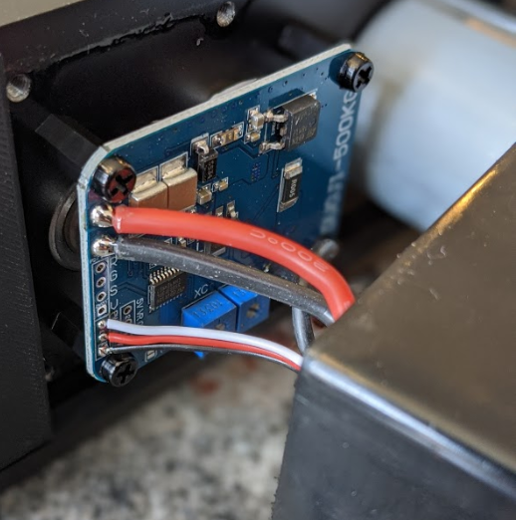

Slide 46
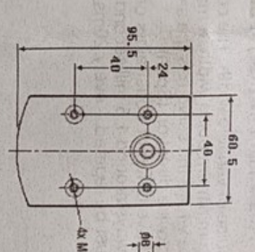
7
109.5
31.5
7

Slide 47
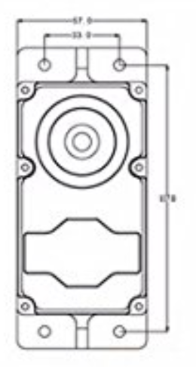
57 mm
33 mm
#10 goes through ( 4.8 mm)
¼ “ does not fit (6.3 mm)
102 mm
11 mm
33 + 12 + 12 = 57

Slide 48
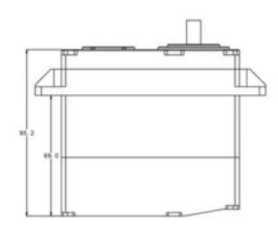
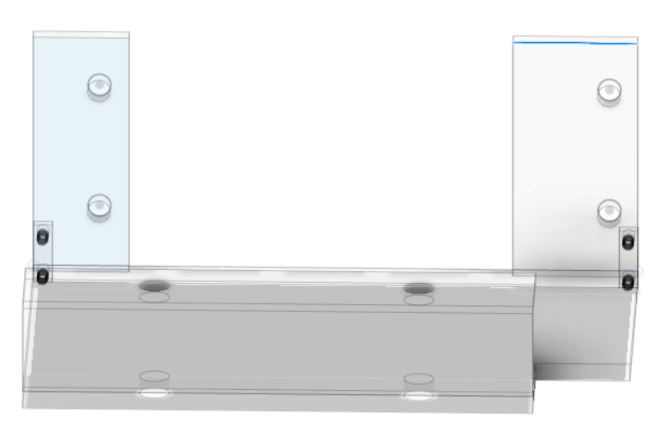
SUPERSERVO 500
67 mm
Need confirmation (for 200 model)
#10 goes through ( 4.8 mm)
¼ “ does not fit (6.3 mm)
34 mm
102 mm
135
33 + 12 + 12 = 57
17 mm
Edge to shaft 111mm
Hole to shaft ~ 10.75” (273mm)

Slide 49
Outside edge of frame
SUPERSERVO 500
25.4
96.3mm
96.3+(2.7*2) mm
107.7

Slide 50
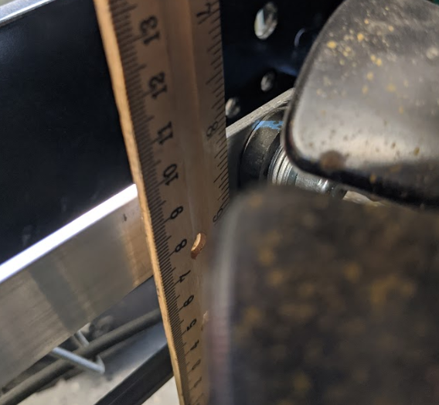
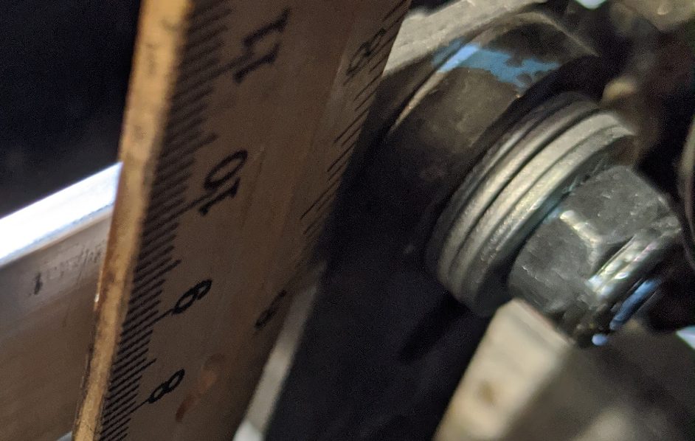
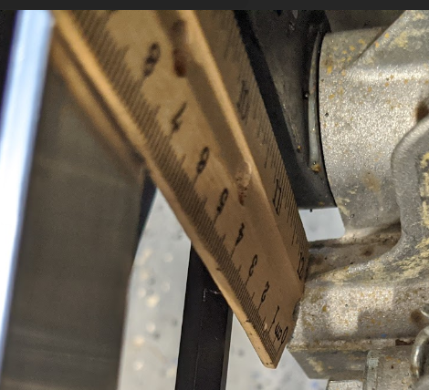
Bottom: 25 mm
Top: 90mm
65mm
Top bolt center: 8.75”
Bottom center: 11”
Therefore center is 2.25”
57.15mm
From the floor to the top of the bolt: 13.5”
342.9mm
Bolt head size: 12.5mm
So 342.9-(12.5/2)=336.65
Floor to bottom of frame 11 3/8 – 11 7/16
11.375” – 11.4375”
288.9 to 290.5mm – use 290
Therefore the distance between the bottom of the frame and the center of the hole is 47mm

Slide 51
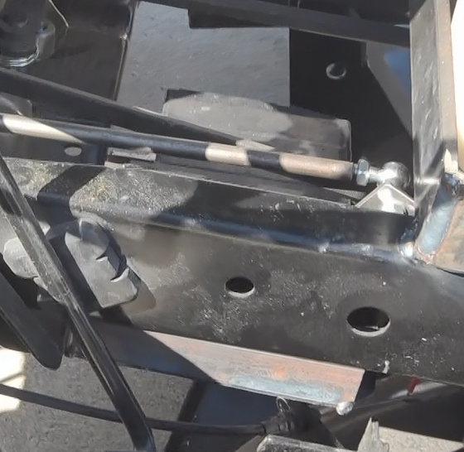
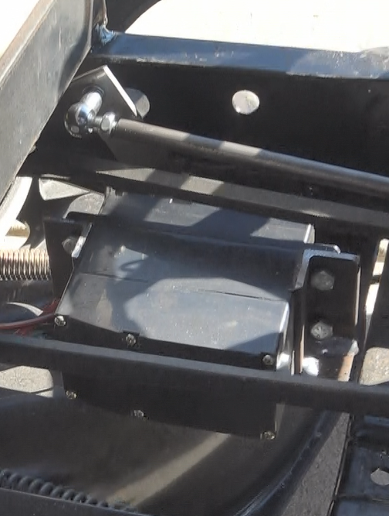
I had to move the control arm to about this position

Slide 52
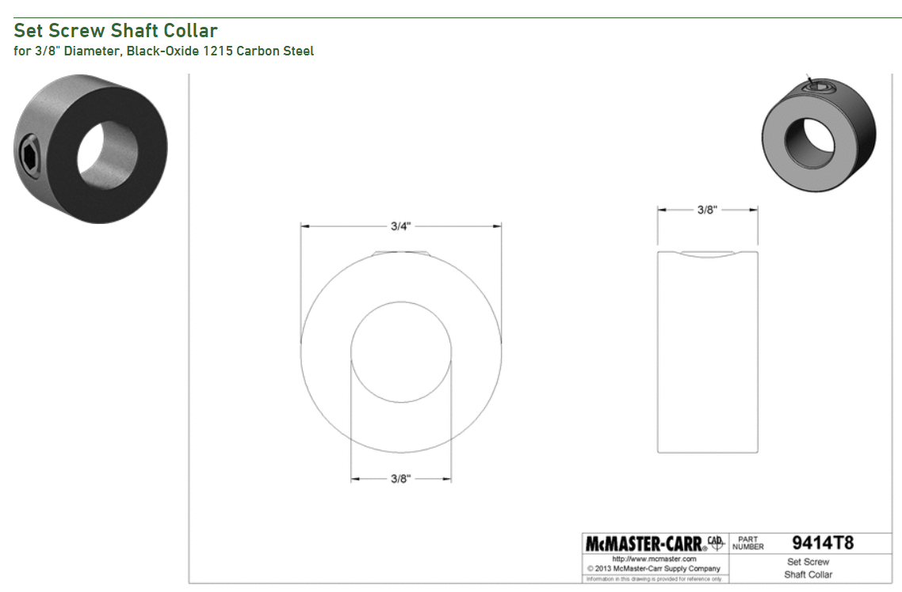


Slide 53

Unit A
Unit B
TX (Unit B)
To
RX (Slave)
RX (Unit A)
To
TX (Master)
Note the Slave LED is lit
Slave
Master

Slide 54


12V battery
Frame
Emergency button
Fuse Block Ground
Magneto

Slide 55


Slide 56

3DR radio
Female RS232 to TTL
converter
Female Rs232 to USB
12 volt to 5 volt converter

Slide 57


Slide 58




32-7.5=24.5
32
AMS AS5600 contactless potentiometer
21.5
7
1.70
3.25
AS5600 Board and IC
1.55
.5
40.75
Magnet
30
24.5-3=21.5

Slide 59
AMS AS5600 contactless potentiometer
4
1.70
.5
5
1.55
5 mm
32
AS5600 Board and IC
Magnet
34 mm
24+3=27
24 mm
3.7 mm
24 mm
24-5.5=19.5 mm
7 mm
10 mm
25.4 mm
40.75

Slide 60


AS5600 Board and IC
1.7 mm
5 mm
7.9 mm
6.2 mm
1.2 mm
2 mm
6.3 mm
1.6 mm
2.3 mm
4 mm
STM32 Board
5/16” = 7.9 mm
5 mm

Slide 61







Slide 62


8
7
4
4
66
4
4
7
88

Slide 63

3
2
1

Slide 64

To 1000

Slide 65



The updated output signal (i.e. neutral or passthrough PWM) goes from 5 (20 on my board) which connects from the mini to the servo board. This pin provide 8-bit PWM output with the analogWrite function.
The original input signal line goes into 2 (15 on my board)
This pin is one of two pins you can attach an external interrupt
https://www.arduino.cc/reference/en/language/functions/external-interrupts/attachinterrupt/

Slide 66



Slide 67




The USB standard requires a 1.5 kΩ pullup resistor on D+, but this board is known to have a wrong value (R10 on the board). It ships with either a 10 kΩ resistor or a 4.7 kΩ resistor, but it should be replaced with a 1.5 kΩ resistor, or put an appropriate resistor value (e.g 1.8 kΩ) in between PA12 and 3.3V. It is also true that some PCs are tolerant of incorrect value so, before you change the resistance, you can try if it works in your case.
Source: http://wiki.stm32duino.com/index.php?title=Blue_Pill
1.8 kΩ
BROWN
BLACK
15K kΩ
10K kΩ
BLUE

Slide 68




Note PB15 is 5V tolerant
Proximity Switch; Model : LJ18A3-8-Z/BX
1.8 kΩ
Pololu 12V Step-Up Voltage Regulator U3V12F12
BROWN
BLACK
4.48K kΩ (R1)
9.95 kΩ (R2)
BLUE
The formula was helpful to get started, but my implementation varied. There may be an internal resistor onboard the sensor. My input is ~12V

Slide 69


Magnetic, Rotary Position Sensor; Model : AS5048B-TS_EK_AB
5 VOLT
4.7K kΩ (R1)
4.7K kΩ (R2)
PB11 (SDA)
PB10 (SCL)
1.8 kΩ

Slide 70

Teensy 3.2
Magnetic, Rotary Position Sensor; Model : AS5048B-TS_EK_AB
5 VOLT
4.7K kΩ (R1)
4.7K kΩ (R2)
PB11 (SDA)
PB10 (SCL)

Slide 71
Steering Control
The target angle (cmd_msg.angular.z) is published in cmd_vel with a range of (??) to (??) with (??) being straight
The target steering angle is converted from rad to deg (steering_angle_deg)
The target is then converted to a number that is within the range produced by the angle sensor (steering_angle_target). For example if the range of the potentiometer is 195 to 450 then use steering_angle_target = mapFloat(steering_angle_deg, 0, 60, 195, 450);
(Question: Why the 0-60 range?)
The actual angle is read with the command steer_angle_val = analogRead(15);
The variance (i.e. error) is calculated steer_err_value = steering_angle_target - steer_angle_val;
The error is put in a message:
  sprintf (buffer, "Steer error : %f", steer_err_value);
  nh.loginfo(buffer);
(Question: How do I display this on the RPi?)

Slide 72




On RC 1 a PWM? Signal between 900-3300 based on emulating a radio control transmitter
BEI DUNCAN 9810-661-3 rugged potentiometer
http://ecatalog.beisensors.com/item/rotary-potentiometers/rotary-potentiometer-9800-series/9811r5kl2-0
12/21/17 Notes:
My challenge is to send a PWM near 1450 when the xtrack starts to grow. Currently the PWM bounces all over the place

Slide 73
So what are the elements of a solution?
Ability to detect variance to AB desired line
  Input from rover to companion computer: RTK GPS Position
  Companion computer: has stored the A and B position; xtrack error will be calculated based on current rover position taken from the rover; the : PWM to achieve lower xtrack error will be output to rover motor controller
Testing steps:
  Ability to send WP’s to Pixhawk in guided mode and let the Pixhawk calculate the steering controller PWM
    Install needed software on second laptop to run Tatiano’s examples while having Mission Planner on Windows machine
    Add 3 WPs
    Switch to Rover
    Change sleep statements by adding code to monitor GPS location and wait until position is achieved.
    Add nvector routines to calculate distance instead of wait commands
    Implement ability to monitor xtrack error or calculate it your self using nVector
    Problem statement:
      If I am 3.727 meters away from my AB line what angle should I pursue to get back to the AB line?
      Once I know the angle what PWM translates to that attack angle
      See pseudo code in Word document “Research – Steering control”
    Questions:
      What is the ratio of PWM to degrees?
    Switch from having the companion computer sending the information via direct connection to sending the information over radio connection
  Stop using the pixhawk steering controller and only send the steering PWM values and perform the WP tracking and guidance on the companion computer.

Slide 74





instruct your UB352 to output RTK position at 10Hz on port 1 and to accept RTCM corrections on port 2

Slide 75



Slide 76
Unit A
Unit B
TX (Unit B)
To
RX (Slave)
RX (Unit A)
To
TX (Master)
Note the Slave LED is lit
Slave
Master

Slide 77



that blue wire you see coming out of the 3DR in the picture is a direct connection from the 3DR to the K501G's Com2 RX port.
Device | Connection | Desc |  | Device | Connection
3DR Radio - 1 | Pin 2 |  |  | Pixhawk | Port – telem 1
3DR Radio - 1 | Pin 3 |  |  | Pixhawk | Port – telem 1
K501G | Pin 11 | COM1_Tx |  | Pixhawk | ??
K501G | Pin 12 | COM1_Rx |  | Pixhawk | ??
K501G | Pin 14 | COM2_Tx |  | 3DR Radio - 2 | ??
K501G | Pin 15 | COM2_Rx |  | 3DR Radio - 2 | Radio Transmitter Pin 3
Source: http://deepsouthrobotics.com/2017/05/23/a-hackers-guide-to-the-k501g/
http://deepsouthrobotics.com/wp-content/uploads/2017/05/K501G_Board_Specification_V2.2.pdf

Slide 78
that blue wire you see coming out of the 3DR in the picture is a direct connection from the 3DR to the K501G's Com2 RX port.
Device | Connection | Desc |  | Device | Connection
3DR Radio - 1 | Pin 2 |  |  | Pixhawk | Port – telem 1
3DR Radio - 1 | Pin 3 |  |  | Pixhawk | Port – telem 1
K501G | Pin 11 | COM1_Tx |  | Pixhawk | ??
K501G | Pin 12 | COM1_Rx |  | Pixhawk | ??
K501G | Pin 14 | COM2_Tx |  | 3DR Radio - 2 | ??
K501G | Pin 15 | COM2_Rx |  | 3DR Radio - 2 | Radio Transmitter Pin 3
Pin Com1 TX
Source: http://deepsouthrobotics.com/2017/05/23/a-hackers-guide-to-the-k501g/
http://deepsouthrobotics.com/wp-content/uploads/2017/05/K501G_Board_Specification_V2.2.pdf

Slide 79
K503 Board
RS232 - TTL
3DR
12V ->5V
12 Volt

Slide 80


K726 Board
Male RS232
RS232 – TTL
Female RS232
TTL Converter
12V ->5V
12 Volt
[16639.819918] usb 1-1.3.1.4: new full-speed USB device number 9 using dwc_otg
[16639.986653] usb 1-1.3.1.4: New USB device found, idVendor=10c4, idProduct=ea60
[16639.986668] usb 1-1.3.1.4: New USB device strings: Mfr=1, Product=2, SerialNumber=3
[16639.986677] usb 1-1.3.1.4: Product: CP2102 USB to UART Bridge Controller
[16639.986685] usb 1-1.3.1.4: Manufacturer: Silicon Labs
[16639.986692] usb 1-1.3.1.4: SerialNumber: 0001
[16639.997466] cp210x 1-1.3.1.4:1.0: cp210x converter detected
[16640.004714] usb 1-1.3.1.4: cp210x converter now attached to ttyUSB0
ubuntu@ubiquityrobot:~$ ^C

Slide 81




Slide 82


BASE (use RXD)
ROVER (use TXD)

Slide 83
Loop back test set up – not complete – testing has failed
Laptop
USB ->TTL
RS232 - TTL
3DR
3DR
12V ->5V
12 Volt

Slide 84


The question is how close can I make the alignment waypoint after the final waypoint for a corner?
I believe the turning radius of the tractor is 35 ft?

Slide 85
35 Ft circumference / 5.5 Ft Radius
45 Ft circumference / 7.2 Ft Radius
circumference / pi = diameter / 2 = radius
45 / 3.14 = 14.3 / 2 = 7.2
90 ft / 3.14 = 28 / 2 = 14.3 ft = 4.4 meters
1ft = .3048 meters
The hypothesis is if the radius of the turning capability of the tractor is 7.2 feet, then the last waypoint before turning should be 7.2 feet before the corner and the next waypoint should be 7.2 feet towards the next corner.
For testing purposes I would double this for the first few runs so you are well away from the fence.
Corner

Slide 86

First cut away from fence = 2.18 meters
½ cutting width
buffer
36"
50"

Slide 87

One option would be to save the last few WPs then run a mission then switch to training and capture the WPs and then reverse engineer the path.

Slide 88


